Slide 1
Tripcarte Dashboard Design
March 2020

Slide 2
Merchant View
Admin

Slide 3

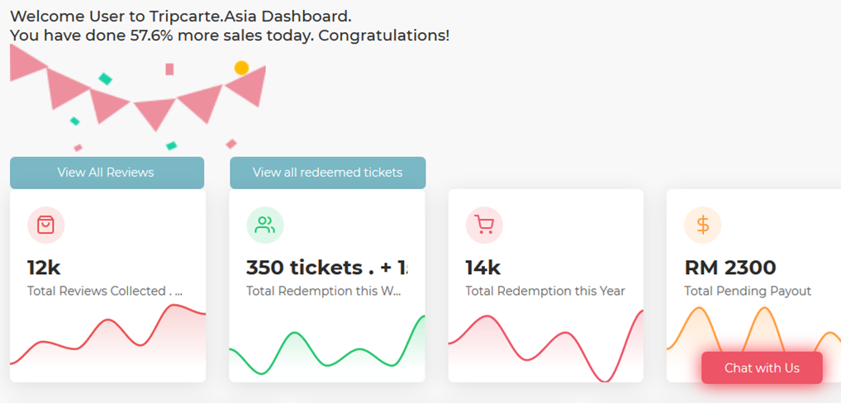
DASHBOARD
PAYOUTS
REDEMPTIONS
PRODUCTS
REVIEWS
SCAN TICKETS
BOOKINGS
SETTINGS

Slide 4
DASHBOARD
SEARCH
SORT
EXPORT
PAYOUTS
Order ID | Item | Commission | Redeemed Quantity | Redeemed Date | Redemption Status | Payment Status | Payment Date | Payment Reference
REDEMPTIONS
PRODUCTS
REVIEWS
SCAN TICKETS
BOOKINGS
SETTINGS

Slide 5
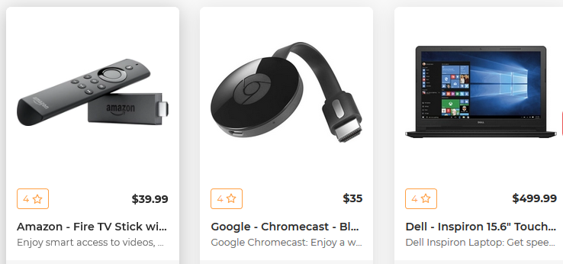
DASHBOARD
SEARCH
SORT
PAYOUTS
REDEMPTIONS
VIEW DETAILS
VIEW DETAILS
VIEW DETAILS
PRODUCTS
REVIEWS
SCAN TICKETS
BOOKINGS
SETTINGS
PAYOUTS
If you would like to make any changes, please send an email to merchant@tripcarte.asia

Slide 6
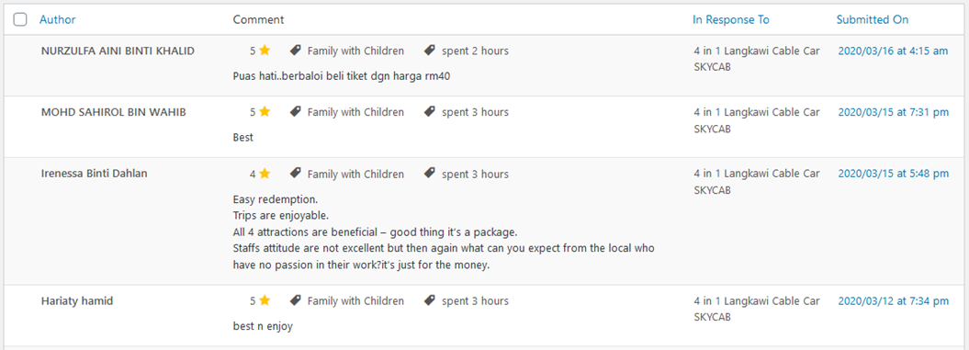
DASHBOARD
SEARCH
SORT
EXPORT
PAYOUTS
REDEMPTIONS
PRODUCTS
REVIEWS
SCAN TICKETS
BOOKINGS
SETTINGS
PAYOUTS

Slide 7
DASHBOARD
SEARCH
SORT
EXPORT
PAYOUTS
Order ID | Item | Quantity | Customer | Selected Date
REDEMPTIONS
PRODUCTS
REVIEWS
SCAN TICKETS
BOOKINGS
SETTINGS
PAYOUTS

Slide 8
Merchant View
Ticket Counter

Slide 9
REDEMPTIONS
SEARCH
SORT
EXPORT
PRODUCTS
Order ID | Item | Customer | Redeemed Quantity | Redeemed By | Redeemed Date
REVIEWS
SCAN TICKETS
BOOKINGS

Slide 10

REDEMPTIONS
PRODUCTS
REVIEWS
SCAN TICKETS
BOOKINGS

Slide 11
Finance View
Admin

Slide 12
DASHBOARD
PAYOUTS

Slide 13
DASHBOARD
SEARCH
SORT
MARK AS PAID
EXPORT
PAYOUTS
Order ID | Total Order ( RM ) | Item | Vendor | Commission | Redeemed Quantity | Redeemed Date | Redemption Status | Payment Status | Payment Date | Payment Reference
3501 | 145.00 | Underwater World Adult Malaysian x 2 | Underwater World | 80.00
3501 | 145.00 | Underwater World Adult Malaysian x 2 | Underwater World | 80.00

